Slide 1

Welcome
to
First Grade
Killearn Lakes Elementary
Open House 2022

Slide 2

Welcome
Welcome to a new school year! We are so excited for a great year in first grade. This is going to be a fun year full of learning and adventure. I cannot wait to watch your child grow throughout the year! ☺

Slide 3

Daily schedule
Journal Writing/SEL
Whole Group Language Arts
Small Group Language Arts
Special Area
Lunch
Math
Developmental Play
Science/Social Studies

Slide 4

Daily folder
Red Folder
Teacher-Parent Communication
Goes home every day and comes back to school every day
Behavioral updates
Updates/Upcoming Events
Don’t forget to sign your child’s folder each night! ☺

Slide 5
FRIDAY FOLDER
Green Folder
Finished schoolwork will be sent home on Fridays along with any notes from school.
*Please be sure to empty your child’s folder each Friday before returning it on Monday.

Slide 6

Homework
Tuesday- Writing Homework
Thursday- Math Homework
*Please be sure to look for homework in your child’s Red Daily Folder. Homework is to be completed the day assigned and returned the following day

Slide 7

Grading
Students are graded according to mastery of the First Grade Florida Standards. A variety of assessments will be used along with teacher observations and daily work to complete the pupil progress report for each child.
A=90-100%
B=80-89%
C=70-79%
N = 69% and below
Students also earn grades for Behavior and Work/Study Skills
Behavior
*Follows Rules
*Demonstrates Self Control
*Handles Conflicts and Problems Appropriately
*Respects Adults and Peers
Work and Study
*Works Cooperatively
*Works Independently
*Exhibits On-Task Behavior
*Completes Assignments
*Follows Directions

Slide 8

spelling
Each week, students will be quizzed on all 8 spelling words and 2 words from the sight word list. Please practice reading and spelling ALL of the words found on the weekly Newsletter.

Slide 9

Discipline plan
Green = Student followed rules with one or no reminders
Yellow = Student needed to be redirected more than once or twice about the same issue
Red = Student needed additional redirection (or major offense such as hitting)
The consequences are as follows:
Yellow= Student/teacher conference
Red = Contact Home
Our School Wide Behavior Plan
Positive Behavior Plan (PBS)
Keep Learning Every Second
By being respectful, responsible, and ready to learn!

Slide 10
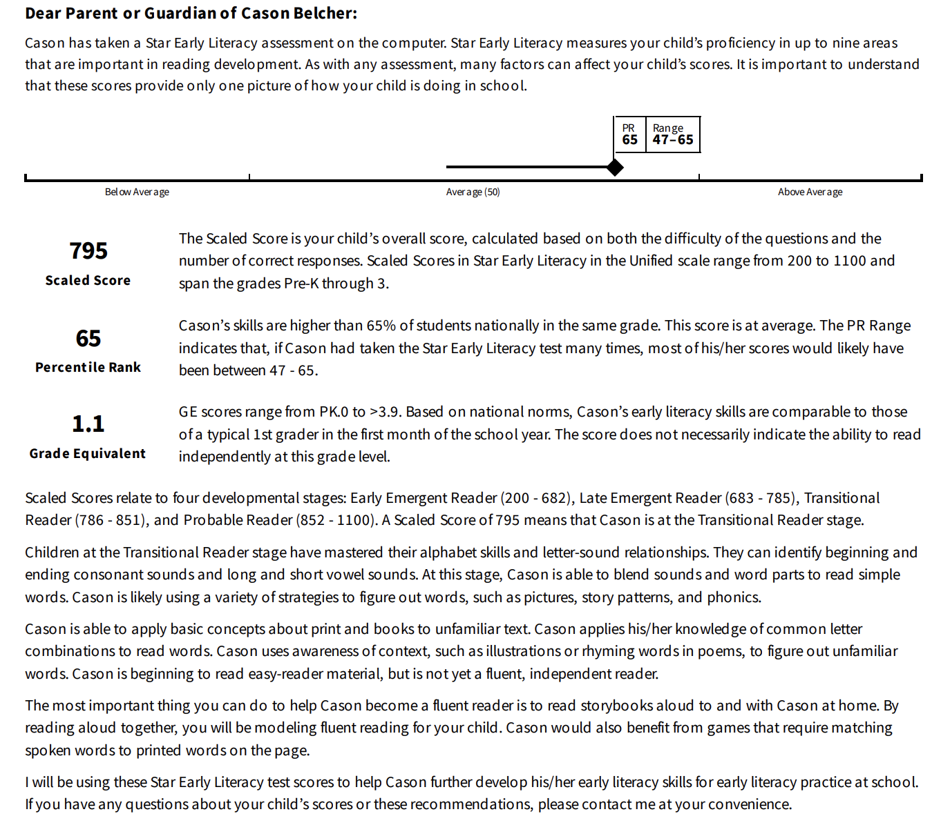
star

Slide 11

AR program
AR is used to encourage independent reading and help develop comprehension skills. Students who score 70% or higher on an AR Test will be given the opportunity to win a free book during our KLES AR drawing on Fridays. This is not part of our reading grade but does provide evidence of extending and applying reading skills. Don’t forget to encourage your child to
READ, READ, READ! ☺

Slide 12
conferences
Conferences are required in First Grade during the first nine weeks.
Please sign up for a Parent/Teacher conference before leaving tonight ☺

Slide 13

Listserv
Please be sure to sign up for Listserv if you have not done so already! This is the best way for our school to communicate with parents about all the important things going on here at KLES. The monthly PTO newsletter and the monthly Leprechaun (school newsletter) are sent out via the Listserv.
You can sign up for Listserv on our Killearn Lakes Website ☺

Slide 14

transportation
Email transportation changes and early pickup notices to both your teacher AND KLES.DismissalChanges@leonschools.net
**Emails must be received by 2:30pm.

Slide 15

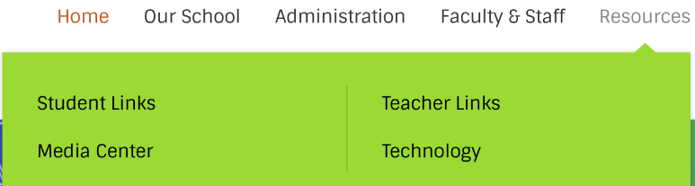
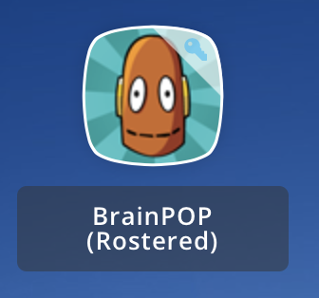
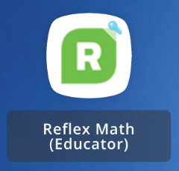
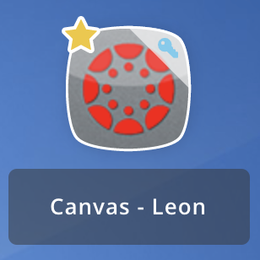

resources
If you are looking for extra resources to utilize at home, please be sure to check out the student resources tab on our Killearn Lakes Website!
You can also access extra resources on your child’s ClassLink Account-
Login codes for these can be found in your child’s
Daily Red Folder ☺
Lexia Core 5- This is our new reading program! Students can access this program at home and work to complete levels to earn certificates
BrainPOP- You can view a variety of fun learning videos.
Reflex Math and Freckle- Great for practice Math Skills!
Canvas- Houses a lot of other great resources for your child such as Seesaw, Teach Your Monster to Read, Prodigy, and Epic!

Slide 16
volunteers
We love to have parent volunteers throughout the year! Please email me if you are interested in volunteering this year!
Prior to volunteering here on campus at Killearn Lakes, you MUST fill out the volunteer form online. You will then need to check with the front office to see if your name is on the approved volunteer list we get from the county. You cannot volunteer in a classroom, anywhere on campus or chaperone a field trip until your name has appeared on the approved list. This may take up to a week to get clearance.
This form can be found at:
https://volunteers.leonschools.net/Volunteers/

Slide 17
General info
Birthday Treats
  We would love to celebrate your child’s birthday at school! If you choose to send in a treat for the class, they must be store bought.
End of Unit Celebrations
  During the school year, we love to have end of unit celebrations (Ex. Spider Fest). Some of the celebrations require a variety of items. Sign Ups will go out for classroom needs ☺
Grades/Report Cards
  Please note, grades and report cards can ONLY be found on your Focus Parent Portal. If you need help accessing this, please reach out.
Make Up Work Policy
  In order to receive a grade in the gradebook, all work must be turned in within 3 days of the date assigned.
PTO Patron
  Please consider becoming a PTO patron. PTO uses funds raised to support our students. Monthly PTO meetings are a great place to learn about what is happening in our school. For more information, visit https://killearnlakespto.org/

Slide 18
School
improvement plan
There are copies of our School Improvement Plan in the Media Center. Feel free to stop by for a copy to read and give input and/or feedback.
Thank you!

Slide 19
Thank you
Thank you so much for joining us this evening! I look forward to getting to know your child more throughout the year. Please be sure to reach out to me if you need anything at all!
Questions? ☺

